Slide 1
St. Stephen’s and St. Agnes School, Alexandria, VA,
November 5, 2017

Slide 2
A world of physics in a tiny ping pong ball …
Dr. M. Ali Yousuf
mali@jhu.edu

Slide 3
Introduction
This will be a discussion based presentation involving you, the students, in learning the physics behind the table tennis game, like:
Which aerodynamic factors play a role in the movement of the ball?
How do we define, select or modify various equipment in table tennis?
How and why the speed of the game is controlled using ball size, etc.

Slide 4
Plan
We’ll start with a short discussion
Then do an activity to understand something
Will return to the presentation to

Slide 5
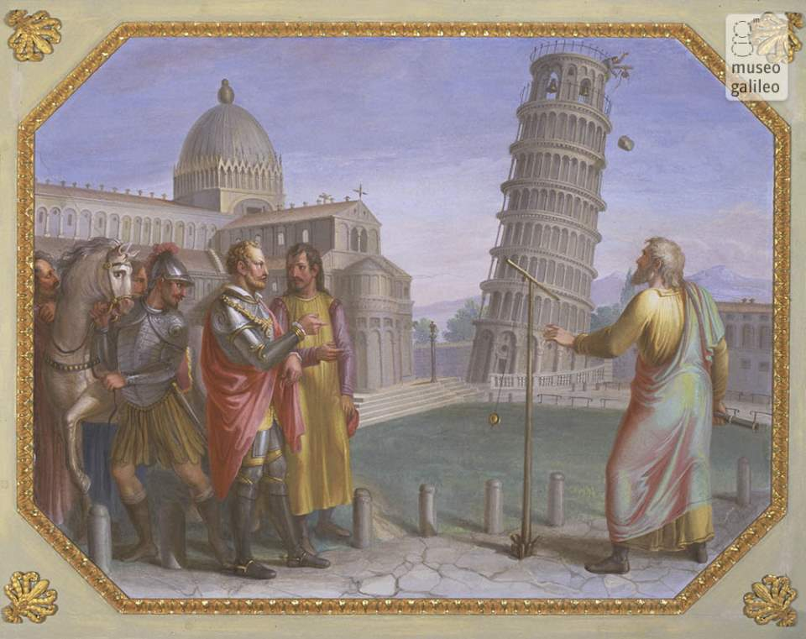
Was Galileo right?
https://ourplnt.com/a-bowling-ball-and-feather-falling-in-a-vacuum-video/galileo-pisa-experiment-luigi-catani/

Slide 6
Can we repeat that experiment?
Yes, but we’ll need to go out to a tall building.
Let’s do something similar but simpler.
We’ll drop things from a slope, to the ground and measure the height and distance as explained on the next page:

Slide 7
Let’s check through measurements: Balls
y
x

Slide 8
Data to be collected: height of the desk, y distance at which the ball drops, x

Slide 9
Let’s Discuss your results Did you see something new, or unexpected?

Slide 10
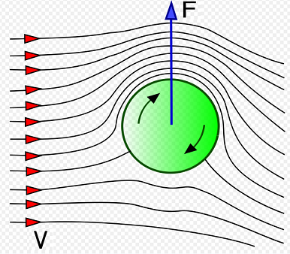
The Magnus Effect (the lift force)
The Magnus Force is perpendicular to the velocity vector of the object.
The direction of spin dictates the orientation of the Magnus force on the object.
The orientation of the force is always perpendicular to the direction of fluid.
http://ffden-2.phys.uaf.edu/211_fall2010.web.dir/Patrick_Brandon/what_is_the_magnus_effect.html

Slide 11
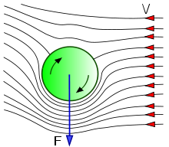

Slide 13
Measurements: Rings
dm
y
x

Slide 14
Data to be collected: 1. height of the desk, y 2. distance at which the ball drops, x 3. the maximum distance from desk, dm

Slide 15
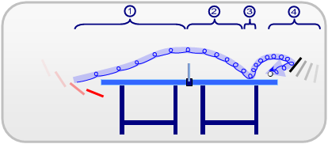
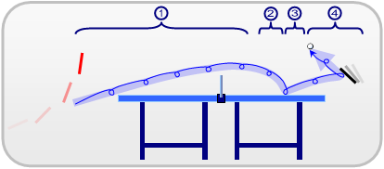
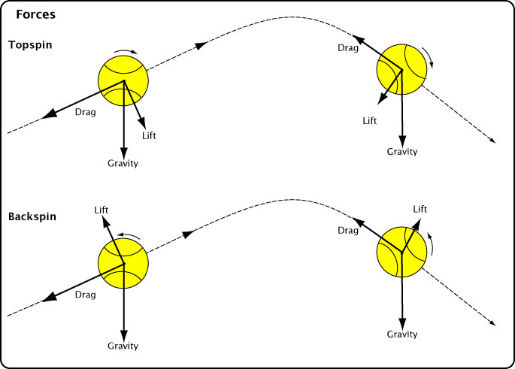
4 phases in a backspin curve
4 phases in a topspin curve
https://en.wikipedia.org/wiki/Table_tennis

Slide 16
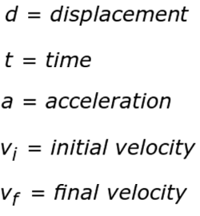
Kinematic Equations for each axis
y
x
x, y
See the sheets given by the instructor to do the remaining calculations …

Slide 17
What is in …
The table
The ball
The racket
…

Slide 18
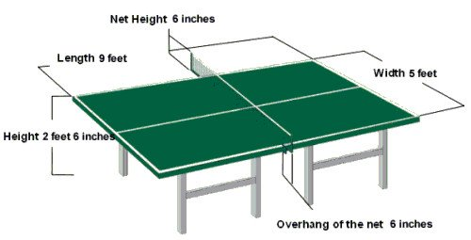
The Table
http://www.allabouttabletennis.com/table-tennis-table.html

Slide 19
The Ball
http://www.allabouttabletennis.com/table-tennis-balls.html

Slide 20
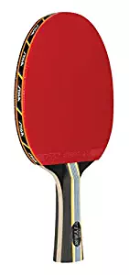
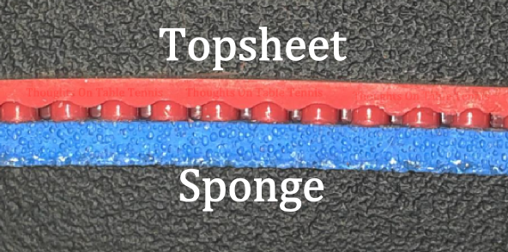
How to choose your table tennis racket:
http://www.allabouttabletennis.com/table-tennis-racket.html
https://thoughtsontabletennis.wordpress.com/2015/03/09/introduction-to-table-tennis-chemistry/

Slide 21
Further Reading:
The Physics of Sports by Michael Lisa
An Introduction to the Physics of Sports by Vassilios Spathopoulos

Slide 22
Videos
Physics and Baseball: An Intersection of Passions, http://youtu.be/aoMiOakuteg.
The Physics of Baseball: You Can Observe a Lot by Watching, http://youtu.be/jVXIX9jc3dw.
Science and Engineering of the 2014 Olympic Winter Games, http://nbclearn.com/science-and-engineering-of-the-2014-olympic-winter-games

Slide 23
What did you learn?

Slide 24
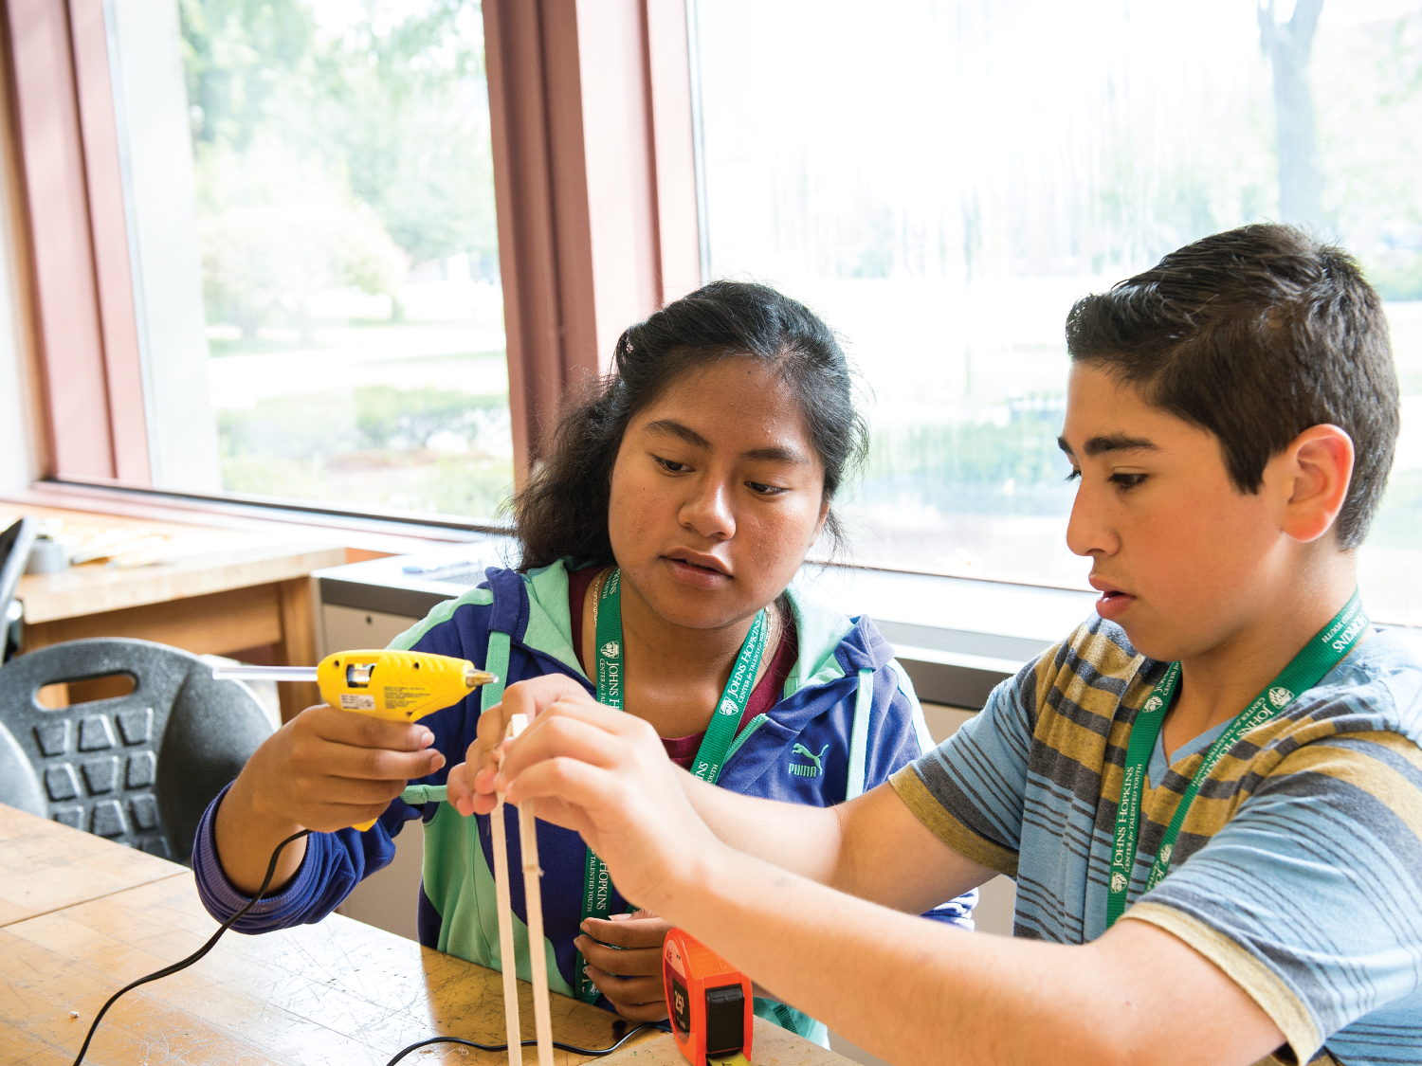
Questions? mali@jhu.edu https://cty.jhu.edu/

